Slide 1
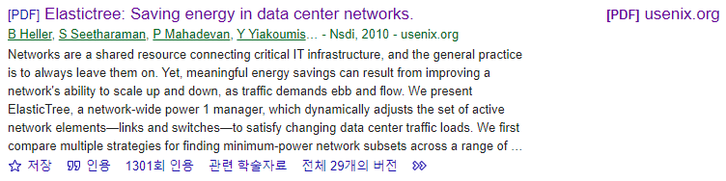
ElasticTree: Saving Energy in Data Center Networks
Brandon Heller⋆ , Srini Seetharaman† , Priya Mahadevan⋄ , Yiannis Yiakoumis⋆ , Puneet Sharma⋄ , Sujata Banerjee⋄ , Nick McKeown⋆ ,
Nsdi. Vol. 10. 2010.
22.12.06.
Cloud Computing
Sohee Kim
Notes:
Heller, Brandon, et al. "Elastictree: Saving energy in data center networks." Nsdi. Vol. 10. 2010.
https://www.usenix.org/legacy/event/nsdi10/tech/full_papers/heller.pdf

Slide 2


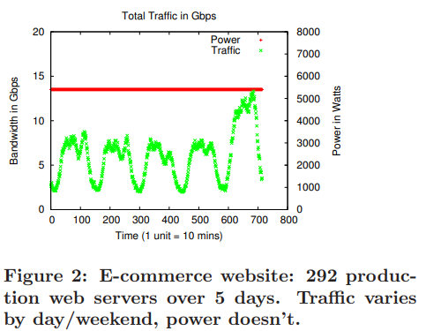
1. Introduction
Heller, Brandon, et al. "Elastictree: Saving energy in data center networks." Nsdi. Vol. 10. 2010.
Data centers consume huge amounts of energy
Most efforts to reduce energy consumption in Data centers is focused on servers and cooling, which account for about 70% of a data center’s total power budget
Networking elements are responsible for 10~20% of power usage in a data center
3 billion kWh in 2006[US] by networking elements -> rising
This paper focus on reducing growing energy cost (network power consumption)
Data centers are typically provisioned for peak workload
During lower traffic, most of the network components are idle, still using power
Traffic collected from 292 servers hosting an E-commerce application over a 5 days period
The traffic peaks during the day and falls at night
Even though traffic varies significantly with time, the associated switches draw a constant power
Notes:
Data centers consume huge amounts of energy, and Most efforts to reduce energy consumption in Data centers is focused on servers and cooling, which account for about 70% of a data center’s total power budget.
Networking elements are responsible for 10~20% of power usage in a data center
The total power consumed by networking elements in data centers in 2006 in the U.S. alone was 3 billion kWh and rising
So This paper focus on reducing this rapidly growing energy cost, network power consumption
Data centers are typically provisioned for peak workload, and run well below capacity most of the time.
During lower traffic, most of the network components are idle, still using power
This figure shows aggregate traffic collected from 292 servers hosting an e-commerce application over a 5 day period.
The traffic peaks during the day and falls at night.
Even though the traffic varies significantly with time, the rack and aggregation switches associated with these servers draw constant power (secondary axis in Figure 2).

Slide 3
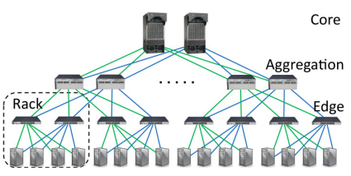
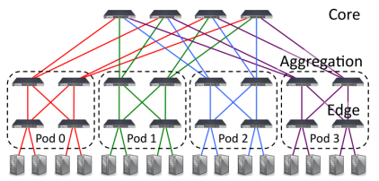
1. Introduction
Heller, Brandon, et al. "Elastictree: Saving energy in data center networks." Nsdi. Vol. 10. 2010.
Data Center Networks
Typical Data Center Network (2N)
Fat tree
Built from a large number of richly connected switches and can support any communication pattern.
In a typical DCN(2N tree) - One failure can cut the effective bisection bandwidth in half, while two failures can disconnect servers.
Richer, mesh-like topologies (like the fat-tree) handle failures more gracefully
With more components and more paths, the effect of any individual component failure becomes manageable
This can be used in improving energy efficiency, by dynamically varying the number of active network elements
It can be thought as a control knob to tune between energy efficiency, performance and fault tolerance
Notes:
As services scale beyond ten thousand servers, inflexibility and insufficient bisection bandwidth have prompted researchers to explore alternatives to the traditional 2N tree topology
One such example, the fat tree , the right Figure, is built from a large number of richly connected switches, and can support any communication pattern
In a typical DCN, 2N tree, the left figure, one failure can cut the effective bisection bandwidth in half, while two failures can disconnect servers.
Richer, mesh-like topologies handle failures more gracefully; with more components and more paths, the effect of any individual component failure becomes manageable.
This property can also help improve energy efficiency. By dynamically varying the number of active (powered on) network elements.
It can be thought as a control knob to tune between energy efficiency, performance, and fault tolerance

Slide 4
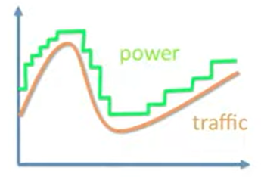
1. Introduction
Heller, Brandon, et al. "Elastictree: Saving energy in data center networks." Nsdi. Vol. 10. 2010.
Energy Proportionality
Unfortunately, today’s network elements are not energy proportional
Fixed overheads such as fans, switch chips, and transceivers waste power at low loads.
However, maximum efficiency can be realized by a combination of improved components and improved component management.
Choice : To manage today’s non energy-proportional network components more intelligently
The Strategy is simple
Turn off the links and switches that we don’t need to keep available only as much networking capacity as required
ElasticTree is a network-wide energy optimizer that continuously monitors data center traffic conditions
It chooses the set of network elements that must stay active to meet performance and fault tolerance goals
Then it powers down as many unneeded links and switches as possible
Goal
It can reduce the energy consumed by a data center network by up to 60% by simply turning off unneeded links and switches
The challenge is to save energy without affecting performance or fault tolerance in a way that scales to data centers with a hundred thousand nodes
Make this graph look like this!
https://www.slideshare.net/abhisheksutrave/elastic-tree-saving-energy-in-data-center-networks
Notes:
Unfortunately, today’s network elements are not energy proportional. Fixed overheads such as fans, switch chips, and transceivers waste power at low loads.
However, maximum efficiency can be realized by a combination of improved components and improved component management.
So, The authors’ choice is to manage today’s non-energy-proportional network components more intelligently
The Strategy in this paper is simple - Turn off the links and switches that we don’t need to keep available only as much networking capacity as required
ElasticTree is a network-wide energy optimizer that continuously monitors data center traffic conditions.
It chooses the set of network elements that must stay active to meet performance and fault tolerance goals
Then it powers down as many unneeded links and switches as possible
**
it can reduce the energy consumed by a data center network by up to 60% by simply turning off unneeded links and switches
The challenge is to save energy without affecting performance or fault tolerance in a way that scales to data centers with a hundred thousand nodes
Their goal is to make this left graph look like this right graph.
Fault tolerance = 고장 허용 범위

Slide 5
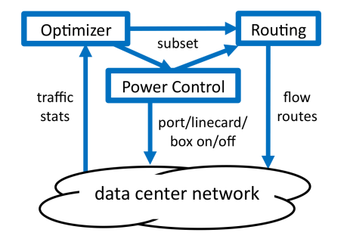
2. ELASTIC TREE
Heller, Brandon, et al. "Elastictree: Saving energy in data center networks." Nsdi. Vol. 10. 2010.
ElasticTree
It is a network-wide power manager, which dynamically adjusts the set of active network elements-links and switches- to satisfy changing data center traffic loads
It consists of three logical modules : Optimizer, Routing, Power Control
Optimizer
To find the minimum power network subset which satisfies current traffic conditions
Inputs : topology, traffic matrix, a power model for each switch, desired fault tolerance properties
Outputs : a set of active components to both the power control and routing modules
Routing
Choosing paths for all flows then pushes routes into the network
Power Control
Toggles the power states of ports, line cards, and entire switches
Choosing paths
toggle
System Diagram
Notes:
ElasticTree is a network-wide power manager, which dynamically adjusts the set of active network elements-links and switches- to satisfy changing data center traffic loads
It consists of three logical modules - optimizer, routing, and power control - as shown in Figure.
**The optimizer’s role is to find the minimum power network subset which satisfies current traffic conditions.
Its inputs are the topology, traffic matrix, a power model for each switch, and the desired fault tolerance properties (spare switches and spare capacity).
The optimizer outputs a set of active components to both the power control and routing modules.
**Power control toggles the power states of ports, line cards, and entire switches,
**while routing chooses paths for all flows, then pushes routes into the network

Slide 6
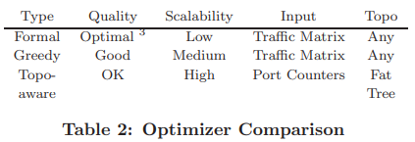
2. ELASTIC TREE
Heller, Brandon, et al. "Elastictree: Saving energy in data center networks." Nsdi. Vol. 10. 2010.
Optimizers
A range of methods to compute a minimum-power network subset in Elastic Tree
Role is to find minimum-power network subset which satisfies current traffic conditions
There are 3 different methods for computing a minimum power network subset
Formal Model
Greedy-Bin Packing
Topology-aware Heuristic
Each method achieves different tradeoffs between scalability(확장성) and optimality(최적성)
Methods can be further improved by considering a data center’s traffic history
Notes:
They have developed a range of methods to compute a minimum-power network subset in ElasticTree, as summarized in Table.
The Role is to find minimum-power network subset which satisfies current traffic conditions
The first method is a formal model, mainly used to evaluate the solution quality of other optimizers, due to heavy computational requirements.
The second method is greedy bin-packing, useful for understanding power savings for larger topologies.
The third method is a simple heuristic to quickly find subsets in networks with regular structure.
Each method achieves different tradeoffs between scalability and optimality
Methods can be further improved by considering a data center’s traffic history

Slide 7
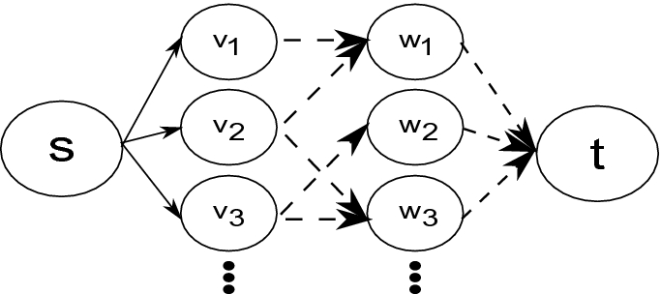
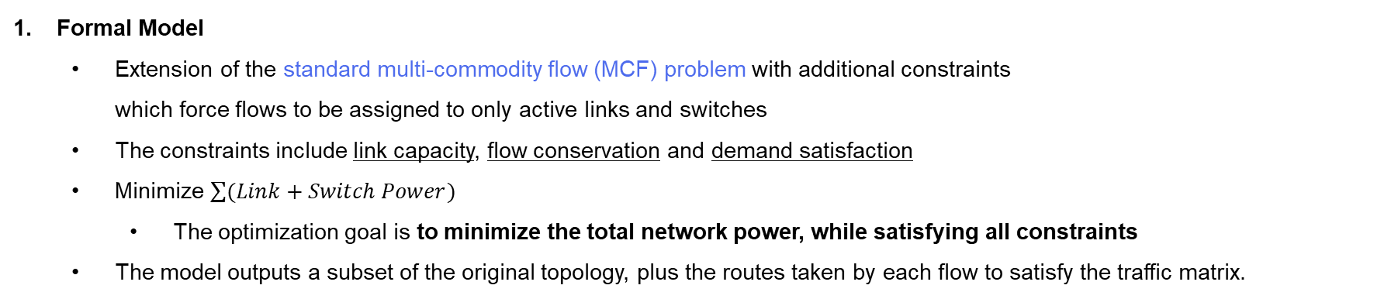
2. ELASTIC TREE
Heller, Brandon, et al. "Elastictree: Saving energy in data center networks." Nsdi. Vol. 10. 2010.
Optimizers
Formal Model
Extension of the standard multi-commodity flow (MCF) problem with additional constraints which force flows to be assigned to only active links and switches
The constraints include link capacity, flow conservation and demand satisfaction
Minimize $\sum{(Link+Switch Power)}$
The optimization goal is to minimize the total network power, while satisfying all constraints
The model outputs a subset of the original topology, plus the routes taken by each flow to satisfy the traffic matrix.
Notes:
The model starts with a standard multicommodity flow (MCF) problem with additional constraints which force flows to be assigned to only active links and switches
The constraints include link capacity, flow conservation, and demand satisfaction. The variables are the flows along each link.
The inputs include the topology, switch power model, and traffic matrix
The optimization goal is to minimize the total network power, while satisfying all constraints.
The model outputs a subset of the original topology, plus the routes taken by each flow to satisfy the traffic matrix.
MCF problem is NP-complete
An instance of the MCF problem can easily be reduced to the Formal Model problem (just the costs for each link and switch to be 0)
So, the Formal Model problem is also NP-complete
It is flexible enough to support arbitrary topologies, but can only scale up to networks with less than 1000 nodes
NP-완전(NP-complete, NP-C, NPC)은 NP 집합에 속하는 결정 문제 중에서 가장 어려운 문제의 부분집합으로, 모든 NP 문제를 다항 시간 내에 NP-완전 문제로 환산할 수 있다. NP-완전 문제 중 하나라도 P에 속한다는 것을 증명한다면 모든 NP 문제가 P에 속하기 때문에, P-NP 문제가 P=NP의 형태로 풀리게 된다. 반대로 NP-완전 문제 중의 하나가 P에 속하지 않는다는 것이 증명된다면 P=NP에 대한 반례가 되어 P-NP 문제는 P≠NP의 형태로 풀리게 된다.

Slide 8
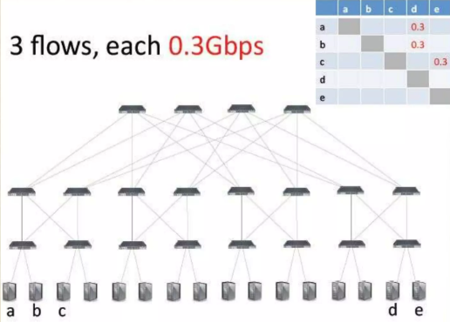
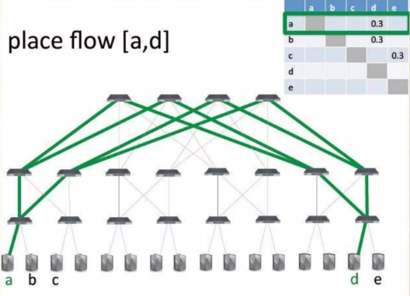
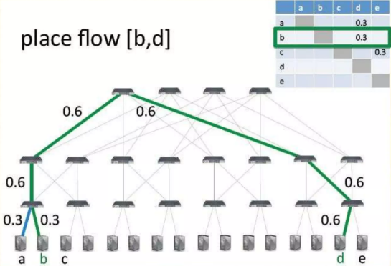
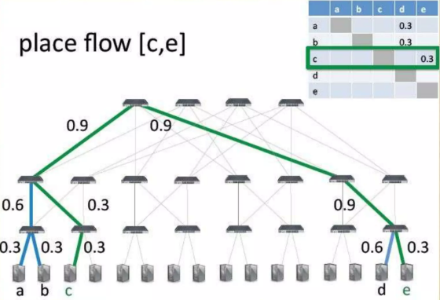
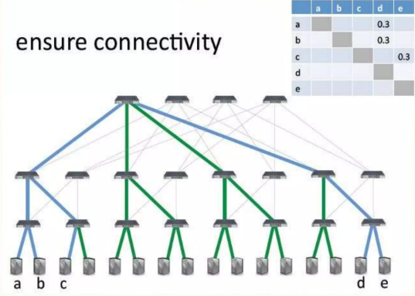
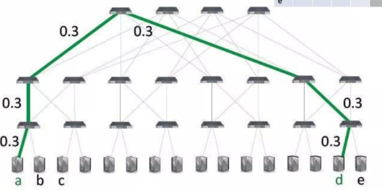
2. ELASTIC TREE
Heller, Brandon, et al. "Elastictree: Saving energy in data center networks." Nsdi. Vol. 10. 2010.
Optimizers
3 flows, each 0.3Gbps
Greedy Bin-Packing
The greedy bin-packing heuristic improves on the formal model’s scalability
Greedy bin-packer evaluates possible paths and chooses the leftmost one with sufficient capacity.
Repeated for all flows
Solutions within a bound of optimal are not guaranteed, but in practice, high quality subsets result.
Place flow [a,d]
Place flow [b,d]
Place flow [c,d]
Ensure connectivity
Notes:
The greedy bin-packing heuristic improves on the formal model’s scalability.
For each flow, the greedy bin-packer evaluates possible paths and chooses the leftmost one with sufficient capacity. Repeated for all flows ****
Solutions within a bound of optimal are not guaranteed, but in practice, high quality subsets result.
For some traffic matrices, the greedy approach will not find a satisfying assignment for all flows;
In this case, the greedy search will have enumerated all possible paths, and the flow will be assigned to the path with the lowest load.
Like the model, this approach requires knowledge of the traffic matrix, but the solution can be computed incrementally, possibly to support on-line usage.

Slide 9
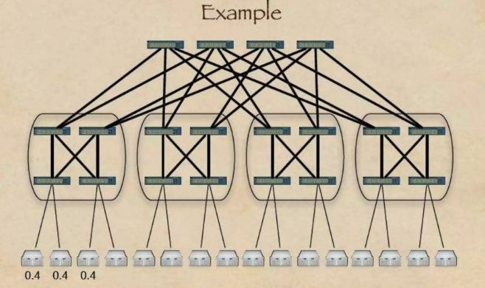
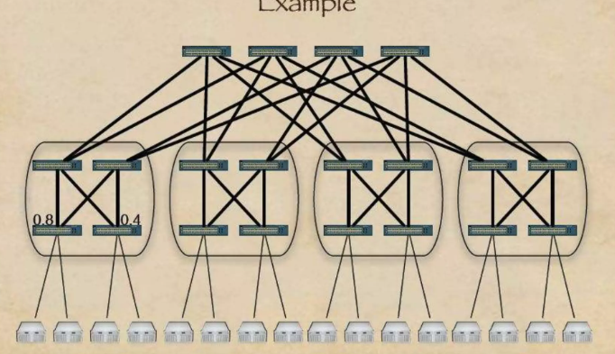
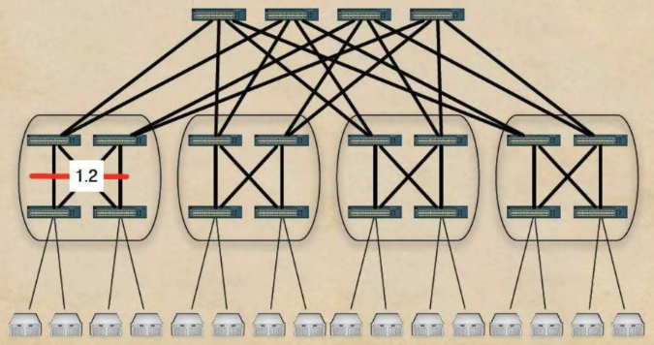
2. ELASTIC TREE
Heller, Brandon, et al. "Elastictree: Saving energy in data center networks." Nsdi. Vol. 10. 2010.
Optimizers
Topology-Aware Heuristic
Leverages regularity of fat tree topology to quickly find network subsets
Unlike the other methods, it does not compute the set of flow routes, and assumes perfectly divisible flows.
Intuition : “An edge switch doesn’t care which aggregation switches are active, instead, how many are active”
0.8
0.4
1.2
0.4
0.4
0.4
Notes:
The last method Topology-Aware Heuristic
leverages the regularity of the fat tree topology to quickly find network subsets.
Unlike the other methods, it does not compute the set of flow routes, and assumes perfectly divisible flows.
The intuition behind heuristic is that to satisfy traffic demands, an edge switch doesn’t care which aggregation switches are active, but instead, how many are active. From the number of active switches, the total power consumed by the Elastic tree can be estimated.
For example, when these 3 are active

Slide 10
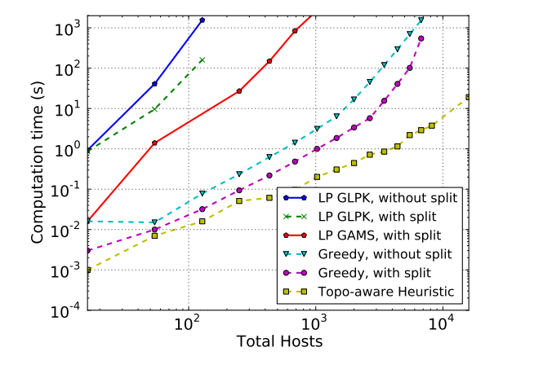
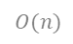
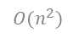
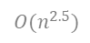
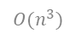
2. ELASTIC TREE
Heller, Brandon, et al. "Elastictree: Saving energy in data center networks." Nsdi. Vol. 10. 2010.
3 Optimizers
Outputs a network topology subset, used by the control software
Scalability
Formal Model
Greedy
Bin-packer
Formal
Model
$$O(n^{3})$$
$$O(n^{2.5})$$
$$O(n^{2})$$
Greedy
Bin-packer
Topo-aware
Heuristic
$$O(n)$$
Optimality (최적성)
Topo-aware
Heuristic
Scalability (확장성)
The topology-aware heuristic approach is not fundamentally unscalable, especially considering that the number of operations increases linearly with the number of hosts.
Notes:
They have implemented all three optimizers; each outputs a network topology subset, which is then used by the control software.
When discussing the scalability of various optimizers in ElasticTree, based on solution time vs network size, as shown in right Figure,
The formal model produces solutions closest to optimal; however for larger topologies (such as fat trees with k >= 14), the time to find the optimal solution becomes intractable.
For greedy bin-packer, The no-split version scaled as about O(n 2.5 ), while the with-split version scaled slightly better, as O(n 2 ) (n = number of hosts)
The topology-aware heuristic fares much better, scaling as roughly O(n), as expected. Subset computation for 10K(ten-thousand) is less than 10 seconds for a single-core, unoptimized
This result implies that the topology-aware heuristic approach is not fundamentally unscalable, especially considering that the number of operations increases linearly with the number of hosts.

Slide 11
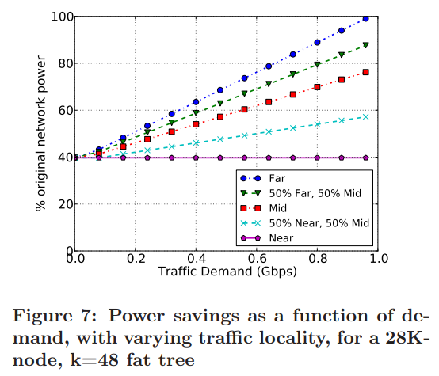
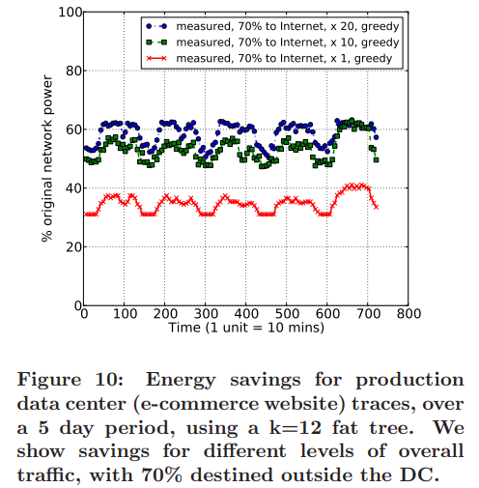
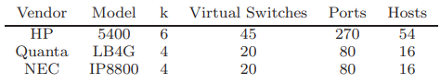
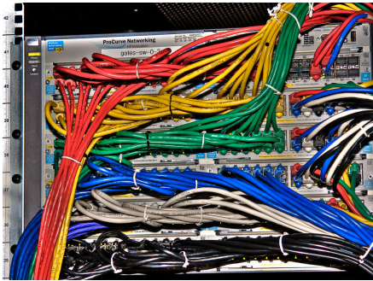
3. POWER SAVING ANALYSIS
Heller, Brandon, et al. "Elastictree: Saving energy in data center networks." Nsdi. Vol. 10. 2010.
$$\% of original network power = \frac{Power consumed by ElasticTree × 100}{Power consumed by original fat tree}$$
== the overall power saved by turning off switches and links
Small tests performed on prototypes
Larger networks tested through simulations
Considered power usage:
Number of switches powered on
Number of ports enabled on them
Ignored power usage:
Running servers hosting ElasticTree modules
Cooling components:
additional energy for cooling servers
decreased energy for cooling switches
Traffic Patterns
> Energy, performance and robustness
Uniform Demand, Varying Locality
Simulation on real traffic data
28K-node, k=48 fat tree
Near = Highly localized
Far = non-localized
E-commerce website, 292 servers
5-day period, k=12 fat tree
⇒ The power consumed by the network
follows the traffic load curve
Fat Tree Configuration
Power savings as a function of demand, with varying traffic locality
Near traffic is the best-case
Far traffic is the worst-case
Energy savings for production data center traces
70% of the traffic leaves the data center
Energy savings ranging from 25-62%
Notes:
They build multiple testbeds to verify and evaluate ElasticTree, summarized in table.
Small tests performed on prototypes, and Larger networks tested through simulations
Considered power usage:
number of switches powered on
number of ports enabled on them
Ignored power usage:
running servers hosting ElasticTree modules
cooling components:
additional energy for cooling servers
decreased energy for cooling switches
In this section, they analyze ElasticTree’s network energy savings when compared to an always-on baseline
The primary metric they inspect is % original network power, computed as above equation.
This percentage gives an accurate idea of the overall power saved by turning off switches and links (i.e., savings equal 100 - % original power)
Energy, performance and robustness all depend heavily on the traffic pattern. And here, I’ll discuss about the possible energy savings over a wide range of communication patterns.
First, consider two extreme cases: near (highly localized) traffic matrices, where servers communicate only with other servers through their edge switch,
and far (non-localized) traffic matrices where servers communicate only with servers in other pods, through the network core.
Near traffic is a best-case — leading to the largest energy savings — because ElasticTree will reduce the network to the minimum spanning tree, switching off all but one core switch and one aggregation switch per pod.
On the other hand, far traffic is a worst-case — leading to the smallest energy savings — because every link and switch in the network is needed.
This graph highlights the power benefit of local communications, but more importantly, shows potential savings in all cases.
Having seen these two extremes, we now consider more realistic traffic matrices with a mix of both near and far traffic
Around 70% of the traffic leaves the data center and the remaining 30% is distributed to servers within the data center.
They simulate the effect of ElasticTree using the greedy bin-packing optimizer on these traces. A fat tree with k = 12 can support up to 432 servers; since our traces are from 292 servers, we assume the remaining 140 servers have been powered off.
For different scaling factors, as well as for different intra data center versus outside data center (external) traffic ratios, we observe energy savings ranging from 25-62%
The main observation when visually comparing with Figure ** (shown at first slide) is that
** the power consumed by the network follows the traffic load curve.
Even though individual network devices are not energy proportional, ElasticTree introduces energy proportionality into the network.

Slide 12
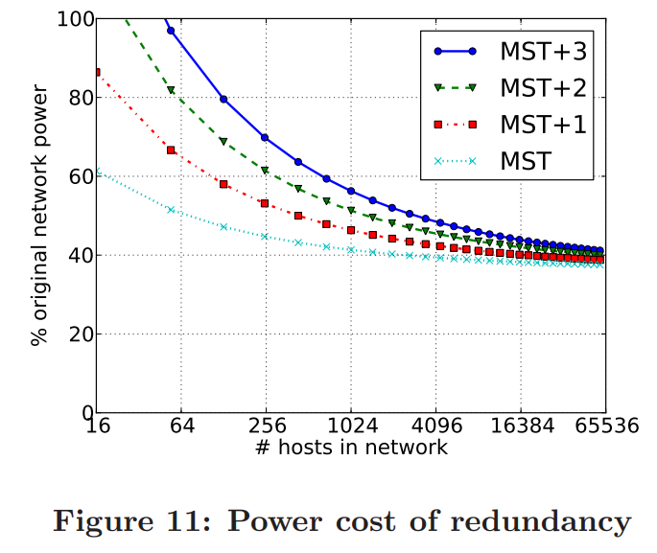
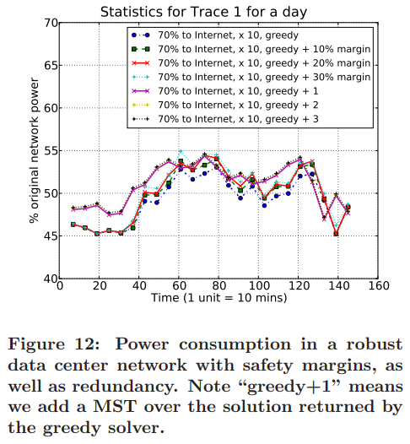
Heller, Brandon, et al. "Elastictree: Saving energy in data center networks." Nsdi. Vol. 10. 2010.
3. POWER SAVING ANALYSIS
Robustness Analysis
Network topology must be prepared for:
Traffic surges
Network failures
Adding a minimum spanning tree (MST) to the power optimized topology enables one failure with no loss of connectivity
Additional energy cost decreases with the size of the topology
Each +1 increment in redundancy has an additive cost, but a multiplicative benefit;
MST+2, the failures would have to happen in the same pod to disconnect a host.
The added cost of fault tolerance is low
The additional power cost incurred is minimal, while improving the network’s ability to absorb unexpected traffic surges.
Notes:
Next is about robustness analysis.
Typically data center networks incorporate some level of capacity margin, as well as redundancy in the topology, to prepare for traffic surges and network failures.
Adding a minimum spanning tree (MST) to the power optimized topology enables one failure with no loss of connectivity
Additional energy cost decreases with the size of the topology
In Figure 11, they extended the MST, minimum spanning tree in the fat tree with additional active switches, for varying topology sizes.
Each +1 increment in redundancy has an additive cost, but a multiplicative benefit; with MST+2, for example, the failures would have to happen in the same pod to disconnect a host.
This graph shows that the added cost of fault tolerance is low
Figure 12 presents power figures for the k=12 fat tree topology when we add safety margins for accommodating bursts in the workload.
We can observe that the additional power cost incurred is minimal, while improving the network’s ability to absorb unexpected traffic surges.

Slide 13
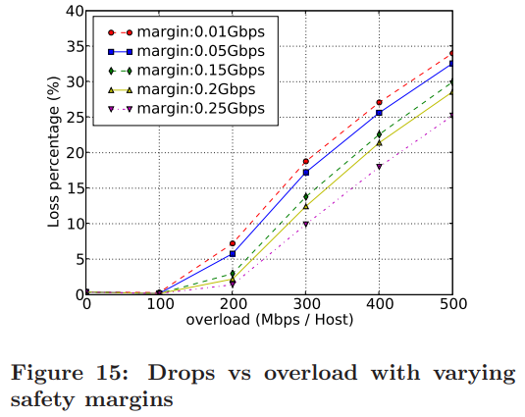
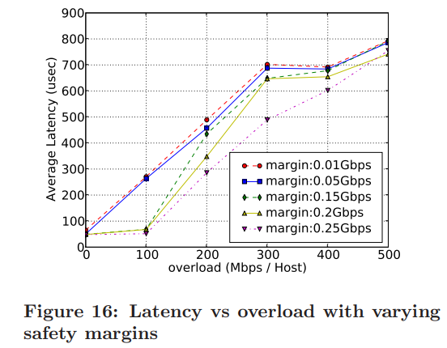
4. Performance
Heller, Brandon, et al. "Elastictree: Saving energy in data center networks." Nsdi. Vol. 10. 2010.
Dropped packets
Latency
Safety margin : the amount of capacity reserved at every link by the optimizer
A higher safety margin provides performance insurance, by delaying the point at which drops start to occur, and average latency starts to degrade
Traffic overload : the amount each host sends and receives beyond the original traffic matrix
No drops for small overloads (up to 100 Mbps), followed by a steadily increasing drop percentage as overload increases
As expected, increasing the safety margin defers the point at which performance degrades
Latency shows a trend similar to drops, except when overload increases to 200 Mbps, the performance effect is more pronounced
⇒ Given these plots, a network operator can choose the safety margin that best balances the competing goals of performance and energy efficiency.
Notes:
Figures 15 and 16 show drops and latency as a function of traffic overload, for varying safety margins
Safety margin is the amount of capacity reserved at every link by the optimizer; a higher safety margin provides performance insurance, by delaying the point at which drops start to occur, and average latency starts to degrade.
Traffic overload is the amount each host sends and receives beyond the original traffic matrix.
Figure 15 shows no drops for small overloads (up to 100 Mbps), followed by a steadily increasing drop percentage as overload increases. As expected, increasing the safety margin defers the point at which performance degrades.
In Figure 16, latency shows a trend similar to drops, except when overload increases to 200 Mbps, the performance effect is more pronounced
Given these plots, a network operator can choose the safety margin that best balances the competing goals of performance and energy efficiency.
For example, a network operator might observe from past history that the traffic average never varies by more than 100 Mbps in any 10 minute span. She considers an average latency under 100 us to be acceptable. Assuming that ElasticTree can transition to a new subset every 10 minutes, the operator looks at 100 Mbps overload on each plot. She then finds the smallest safety margin with sufficient performance, which in this case is 150 Mbps. The operator can then have some assurance that if the traffic changes as expected, the network will meet her performance criteria, while consuming the minimum amount of power.

Slide 14
5. Conclusion
Heller, Brandon, et al. "Elastictree: Saving energy in data center networks." Nsdi. Vol. 10. 2010.
ElasticTree
Introduces energy proportionality in today’s non-energy proportional networks (which through data-center-wide traffic management and control)
A first step toward a more efficient data center network.
3 Algorithms – Formal model, Greedy Bin-Packing and Topology-aware Heuristic
applied on E-commerce data center, and found that power consumption can be reduced
The highly flexible system allows for balancing between performance, robustness and energy
Initial results (covering analysis, simulation, and hardware prototypes) suggest very significant power benefits for networks with varying utilization
ElasticTree’s ability to respond to sudden increases in traffic is currently limited by the switch boot delay, but this limitation can be addressed, relatively simply, by adding a sleep mode to switches
During periods of low to mid utilization, and for a variety of communication patterns (as is often observed in data centers), ElasticTree can maintain the robustness and performance, while lowering the energy bill
Notes:
To this end, They have built ElasticTree, which through data-center-wide traffic management and control, introduces energy proportionality in today’s non-energy proportional networks.
It is a first step toward a more efficient data center network.
They developed 3 Algorithms –Formal model, Greedy Bin-Packing and Topology-aware Heuristic. They are applied on E-commerce data center, and found that power consumption can be reduced
And The highly flexible system allows for balancing between performance, robustness and energy
The initial results (covering analysis, simulation, and hardware prototypes) suggest very significant power benefits for networks with varying utilization
ElasticTree’s ability to respond to sudden increases in traffic is currently limited by the switch boot delay, but this limitation can be addressed, relatively simply, by adding a sleep mode to switches.
During periods of low to mid utilization, and for a variety of communication patterns (as is often observed in data centers), ElasticTree can maintain the robustness and performance, while lowering the energy bill.

Slide 15
Thank You ☺

